Slide 1
NIT-T SUMMER INTERNSHIP 2024
HEALTHCARE TEXT CLASSIFICATION
USING MACHINE LEARNING
Leveraging NCBI Data and Advanced NLP Techniques

Slide 2
TABLE OF CONTENTS
Problem Statement and the Objective
Scraping from PubMed/ NCBI API
Text Processing - (TF-IDF, Doc2Vec)
Experimentation and Comparison of Training Models
Model Training - BERT
Model Evaluation
Predicting the label - Example user Inputs and Outputs
Potential Improvements

Slide 3
01
PROBLEM STATEMENT AND
THE OBJECTIVE

Slide 4
THE CHALLENGE
Efficiently classify healthcare texts into key categories: prevention, diagnosis, and treatment.
Enhance the organization and accessibility of medical information for researchers and healthcare professionals.
THE OBJECTIVE
Develop a robust machine learning model to accurately categorize healthcare-related texts.
Utilize NCBI PubMed data, advanced text preprocessing techniques, and BERT for precise classification.

Slide 5

02
SCRAPING FROM NCBI-PubMed API

Slide 6
SCRAPING STRATEGY
Leverage precise queries to fetch articles tailored to our classification needs, focusing on prevention, diagnosis, and treatment.
Extract crucial metadata including article IDs, titles, and abstracts to feed our machine learning model.

Slide 7
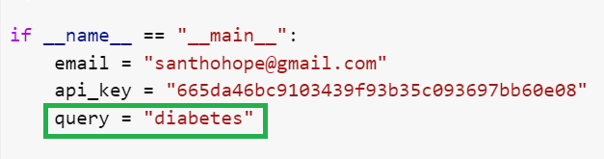
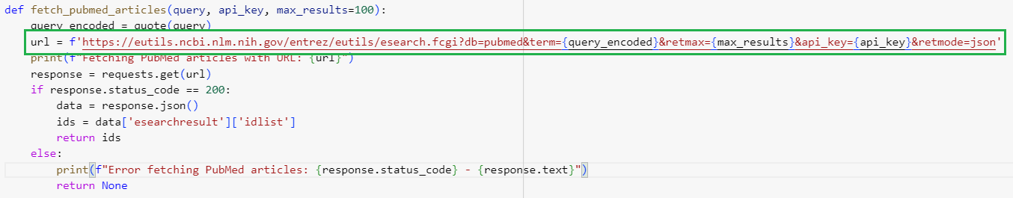
SCRAPING STRATEGY

Slide 8
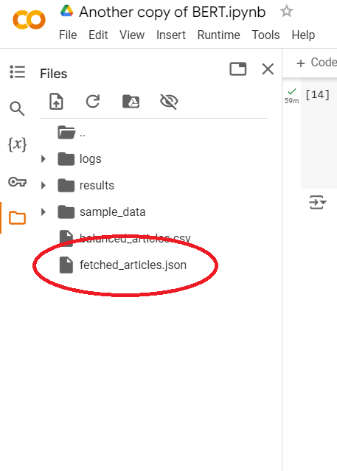
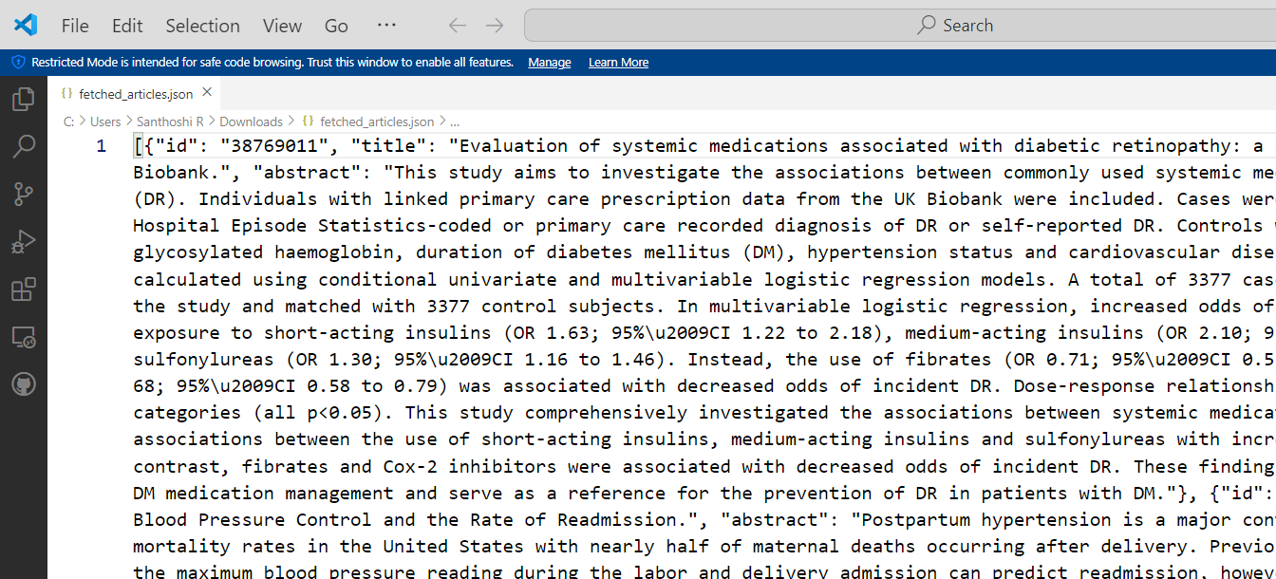

Slide 9
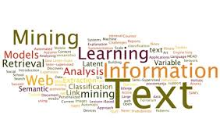
03
TEXT PROCESSING

Slide 10
TECHNIQUE USED
(i) TF - IDF
TF - IDF stands for Term Frequency - Inverse Document Frequency.
A numerical statistic that reflects the importance of a word in a document relative to a collection of documents or corpus. It is widely used in text mining and information retrieval to weigh the significance of terms based on how frequently they appear.

Slide 11
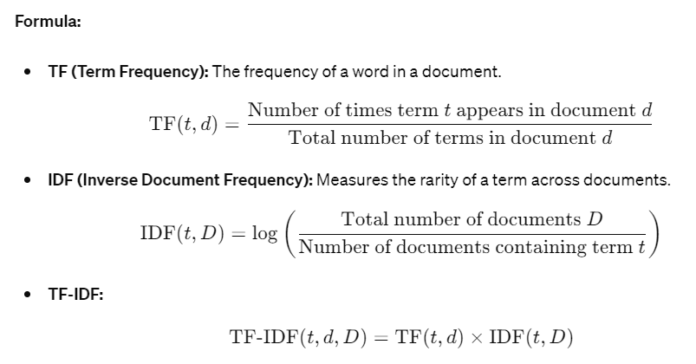
TF - IDF (Term Frequency - Inverse Document Frequency)

Slide 12
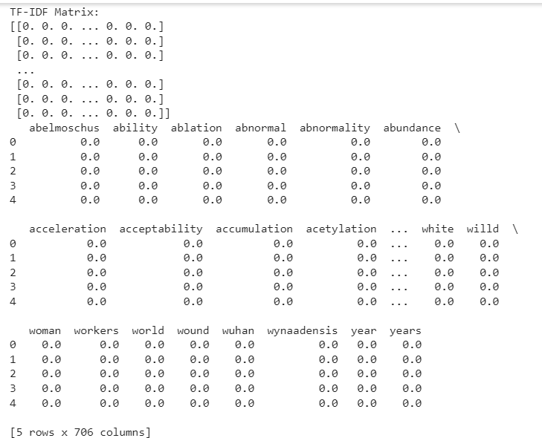
TF - IDF (Term Frequency - Inverse Document Frequency)
TF - IDF Matrix:
Colab note link:
https://colab.research.google.com/drive/1_iosnPYPK73cCMd2HyiL29beA0iE8OCv?usp=sharing

Slide 13
TF - IDF (Term Frequency - Inverse Document Frequency)
EXAMPLE:
BEFORE TEXT PROCESSING
Title: Association between lipid accumulation product and psoriasis among adults: a nationally representative cross-sectional study.
Abstract: Lipid accumulation product (LAP) is an accessible and relatively comprehensive assessment of obesity that represents both anatomical and physiological lipid accumulation. Obesity and psoriasis are potentially related, according to previous research. Investigating the relationship between adult psoriasis and the LAP index was the goal of this study.
AFTER TEXT PROCESSING
Title: Association lipid accumulation product psoriasis among adult nationally representative crosssectional study
Abstract: Lipid accumulation product LAP accessible relatively comprehensive assessment obesity represents anatomical physiological lipid accumulation Obesity psoriasis potentially related according previous research Investigating relationship adult psoriasis LAP index goal study
https://colab.research.google.com/drive/1mgR1kju5jooQ0bXQsnLe60XNt9PbPXJi?usp=sharing

Slide 14
TECHNIQUE USED
(ii) DocToVec
DEFINITION:
Doc2Vec is an extension of the Word2Vec model that learns to represent documents as fixed-length feature vectors. This algorithm preserves the semantic meaning of words within documents, facilitating more nuanced text analysis and comparison.
MECHANISM:
Similar to Word2Vec, Doc2Vec transforms text into a numerical form where the semantic information and document context are encoded. Unlike Word2Vec, which focuses only on words, Doc2Vec also considers the document's label or identifier in its feature space, enabling it to represent entire documents effectively.
PURPOSE:
Doc2Vec is used for tasks like document similarity, document classification, and recommendation systems where understanding the document as a whole is crucial.

Slide 15
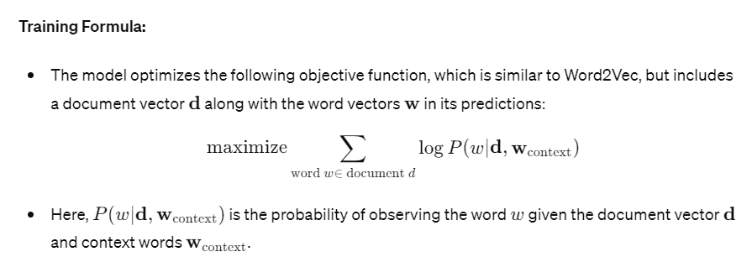
DocToVec:

Slide 16
04
EXPERIMENTATION AND COMPARISON OF TRAINING MODELS

Slide 17
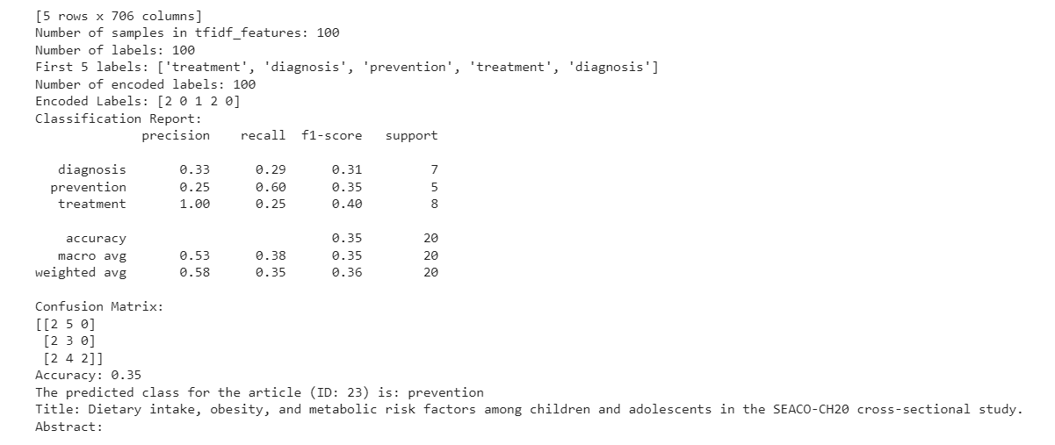
PRELIMINARY MODEL : LOGISTIC REGRESSION
EXPERIMENTAL RESULTS (OUTPUT):
Used TF-IDF(Text processing) + Logistic Regression(Model Training)
Colab note link: https://colab.research.google.com/drive/1sxjThhXWF6T3dQgMh5JTqqGDTnlKsWt7?usp=sharing

Slide 18
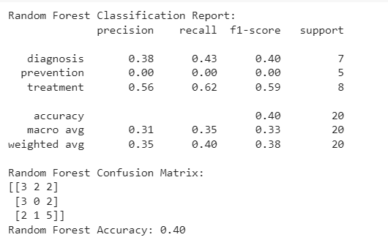
INTERMEDIATE MODEL : (i) RANDOM FOREST
EXPERIMENTAL RESULTS (OUTPUT):
Used TF-IDF(Text processing) + Random Forest(Model Training)
Colab note link:https://colab.research.google.com/drive/1Haexhs8ozV4pHPUQHSLnJ5Wjkw6hQLGI?usp=sharing

Slide 19
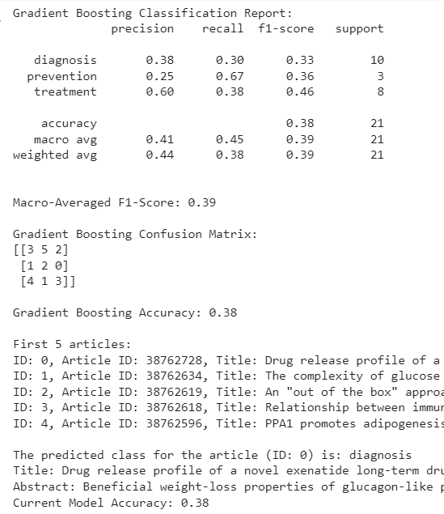
INTERMEDIATE MODEL : (ii) GRADIENT BOOST
EXPERIMENTAL RESULTS (OUTPUT):
Used TF-IDF(Text processing) + Gradient Boost(Model Training)
Colab note link:
https://colab.research.google.com/drive/1F_UXapMvVwh3l7-106UE_BthwSpZPOfO?usp=sharing

Slide 20
05
MODEL TRAINING
-BERT

Slide 21
BERT:
Contextual Understanding:BERT (Bidirectional Encoder Representations from Transformers) is a groundbreaking model in NLP developed by Google. It uses bidirectional training of Transformer, a deep learning model, to generate contextual representations of words in a text.
Fine-Tuning Mechanism:BERT excels in understanding the context of each word within a text by considering the words before and after it. This capability makes it highly effective for tasks like text classification where nuances in phrasing can alter meanings significantly, essential for distinguishing between categories like diagnosis, treatment, and prevention.
State-of-the-Art Performance:BERT has achieved state-of-the-art results on a variety of text classification benchmarks. Its deep bidirectional nature allows it to outperform other models that might only analyze text from one direction, ensuring that our model captures all aspects of the input data for more accurate classification of medical articles.

Slide 22
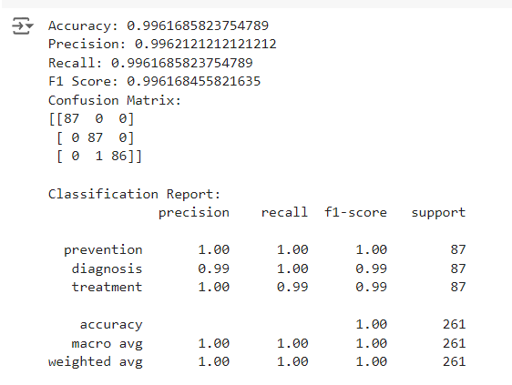
BERT:
Final Colab note link: https://colab.research.google.com/drive/1zPSUcvkJ4VPGGV5mH7PCZrK3A51TMG2l?usp=sharing
Used BERT(model training) + Doc2Vec(text processing)

Slide 23
06
MODEL EVALUATION

Slide 24
MODEL EVALUATION
Accuracy: 0.9961685823754789
This indicates that 99.62% of the predictions made by the model are correct. It is an overall measure of how often the model correctly classifies the articles.
Precision: 0.9962121212121212
Precision is about the quality of the positive predictions made. A precision of 99.62% means that when the model predicts an article belongs to a specific class, it is correct 99.62% of the time.

Slide 25
MODEL EVALUATION:
Recall: 0.9961685823754789
Recall: Recall measures how many actual positive instances were correctly identified by the model. A recall of 99.62% indicates that the model is identifying 99.62% of the actual instances for each class.
F1 Score: 0.996168455821635
The F1 score is the harmonic mean of precision and recall, providing a balance between the two. An F1 score of 99.62% suggests a very balanced performance between precision and recall.

Slide 26
MODEL EVALUATION:
CONFUSION MATRIX:
| Predicted: Prevention | Predicted: Diagnosis | Predicted: Treatment |
| Actual: Prevention | 87 | 0 | 0
| Actual: Diagnosis | 0 | 87 | 0
| Actual: Treatment | 0 | 1 | 86
Class 0 (prevention): 87 articles correctly classified as prevention, 0 misclassified.
Class 1 (diagnosis): 87 articles correctly classified as diagnosis, 1 misclassified as treatment.
Class 2 (treatment): 86 articles correctly classified as treatment, 0 misclassified.

Slide 27
07
PREDICTING THE LABEL - EXAMPLE USER INPUTS AND OUTPUTS

Slide 28
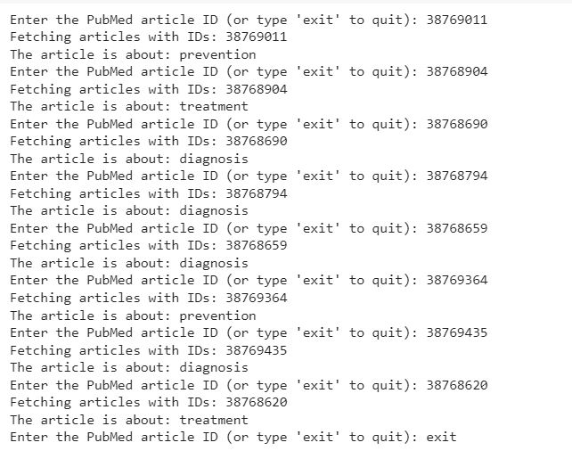
PREDICTING THE LABELS AS (0-Prevention / 1-Diagnosis / 2-Treatment): Sample I/O Screenshot

Slide 29
08
POTENTIAL IMPROVEMENTS

Slide 30
POTENTIAL IMPROVEMENTS:
Topic Modelling: Discover underlying topics in medical documents to categorize content beyond basic classifications. Use Latent Dirichlet Allocation (LDA) or Non-negative Matrix Factorization (NMF) for topic discovery.
Named Entity Recognition:Extract key medical entities (e.g., drugs, symptoms, diseases) to enhance data linking and utility.Utilize tools like spaCy or Stanford NLP, or train custom models to identify specific medical entities.
Anomaly Detection:Identify unusual patterns or outliers in texts that may indicate data entry errors or rare medical cases. Apply statistical techniques or machine learning models like isolation forests or autoencoders for anomaly detection.

Slide 31
POTENTIAL IMPROVEMENTS:
Automated Summarization: Generate brief summaries of lengthy medical documents to save time and improve data accessibility. Create or adapt existing text summarization models using sequence-to-sequence or transformer architectures.
Question Answering System: Develop systems that answer natural language queries based on medical document content, supporting education and patient care. Implement a question answering model using the transformer architecture to process medical articles.

Slide 32
References:
https://nlp.stanford.edu/IR-book/pdf/irbookonlinereading.pdf
https://assets.cambridge.org/97805218/65715/frontmatter/9780521865715_frontmatter.pdf
https://www.geeksforgeeks.org/comparing-word2vec-sentence2vec-and-doc2vec-a-comprehensive-analysis/
https://en.wikipedia.org/wiki/BERT_(language_model)
https://www.ncbi.nlm.nih.gov/home/develop/api/

Slide 33

THANK YOU

